Slide 1

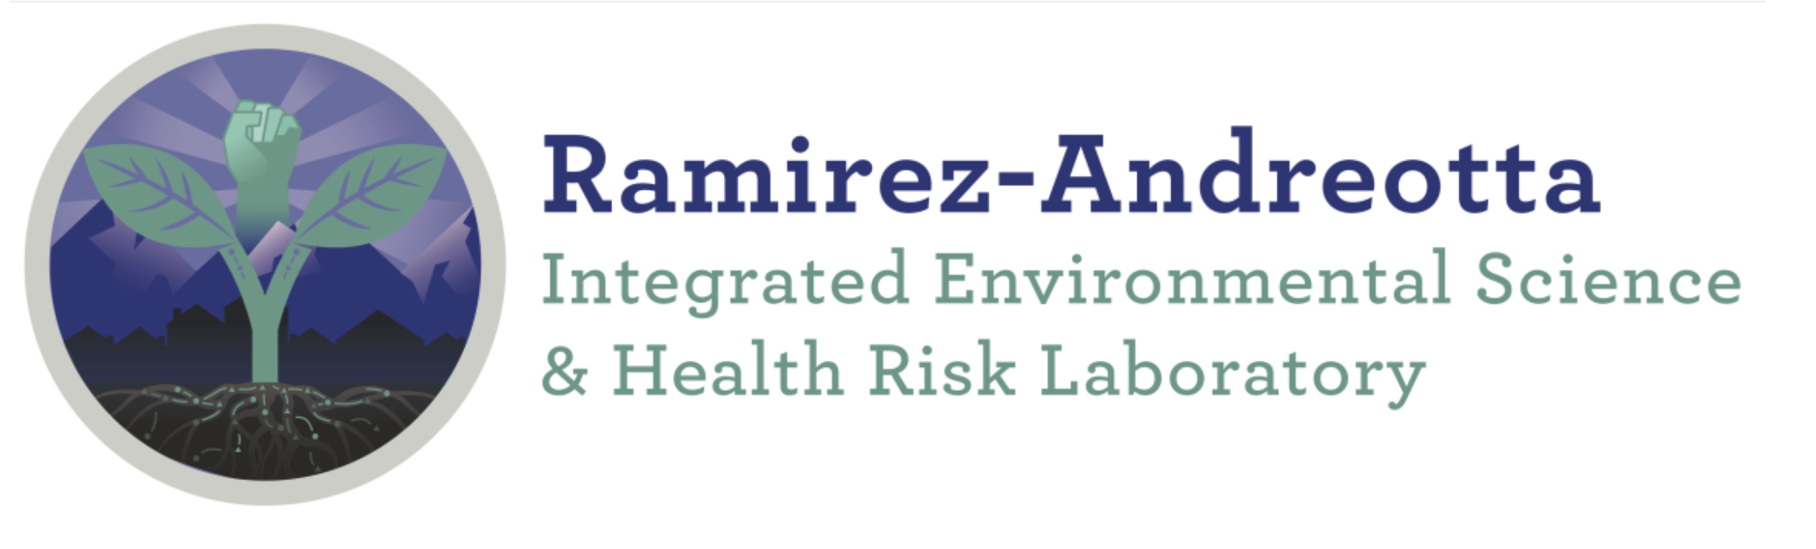


Measuring Dioxin and Dioxin-Like Compounds in Soil and Sediments Impacted by Wildfires and Flash Flooding
Camille Tinerella¹, God’sgift N. Chukwuonye¹, Dr. Mónica Ramírez-Andreotta^{1,2}
¹Department of Environmental Science, College of Agriculture and Life Sciences, University of Arizona, Tucson, AZ, USA
²Division of Community, Environment & Policy, Mel and Enid Zuckerman College of Public Health, University of Arizona, Tucson, AZ, USA
UArizona NASA Space Grant Symposium, DoubleTree by Hilton
Hotel Phoenix-Tempe, Tempe, AZ, USA, April 22nd, 2023

Slide 2
Land Acknowledgement
We respectfully acknowledge the University of Arizona is on the land and territories of Indigenous peoples. Today, Arizona is
home to 22 federally recognized tribes, with Tucson being
home to the O’odham and the Yaqui. Committed to diversity
and inclusion, the University strives to build sustainable
relationships with sovereign Native Nations and Indigenous
communities through education offerings, partnerships, and
community service.

Slide 3
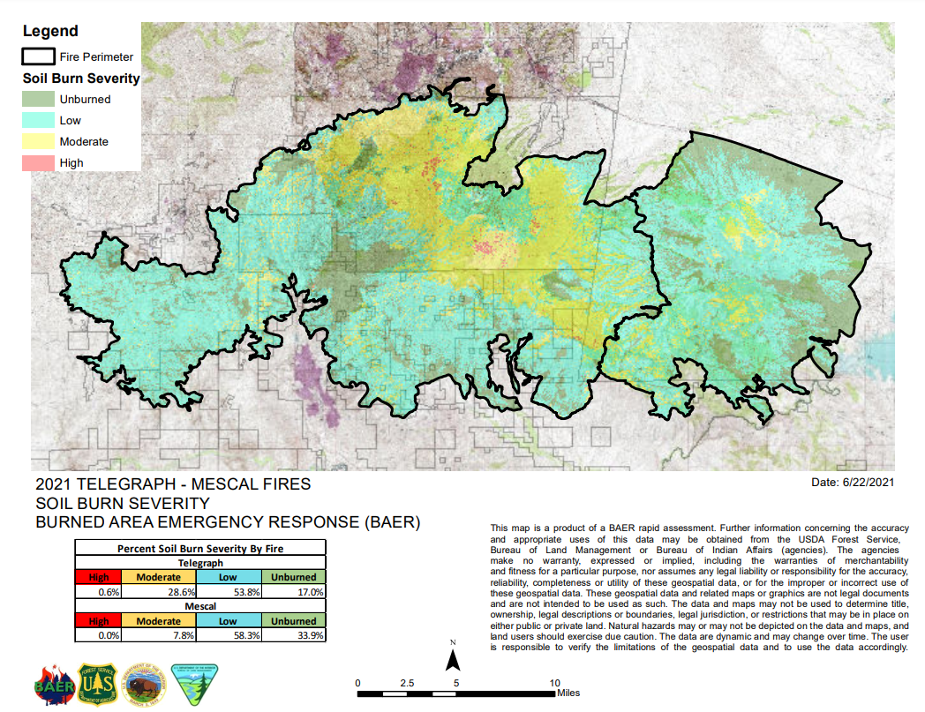
Background – Mescal-Telegraph Fire
Burned from June 4th, 2021, to July 3rd, 2021
Over 250,000 acres burned
Extreme subsequent flooding
Source: https://ein.az.gov/files/map-telegraph-and-mescal-fires-6-22-2021png
Source: https://www.bestplaces.net/city/arizona/miami

Slide 4
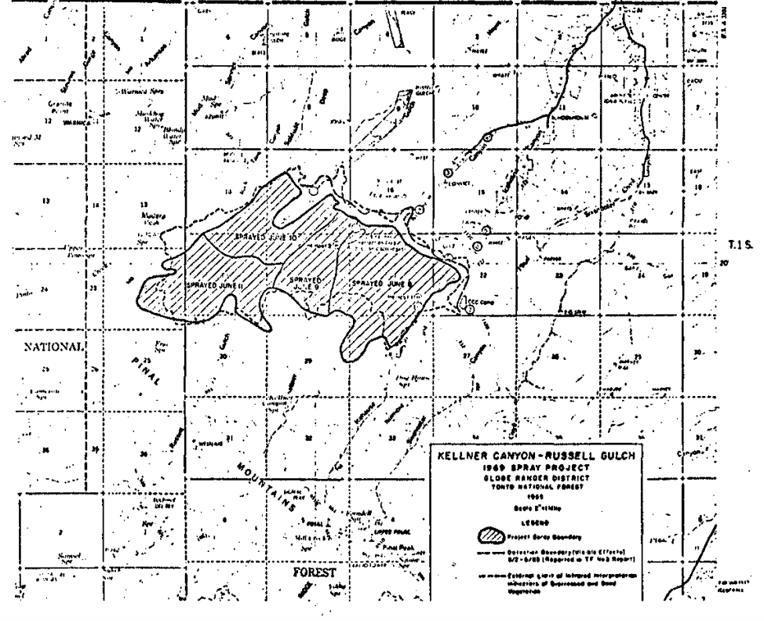
Background – Pinal Mountains Spraying
Kellner Canyon-Russel
Gulch Spray Project
Sprayed herbicide in
1965, 1966, 1968, & 1969
Composed of silvex and
2,4,5-T
Herbicide later was found to contain 0.5 ppm of
2,3,7,8-TCDD
Source: https://www.nal.usda.gov/exhibits/speccoll/files/original/9e8c32ede8a6fc51a1e906e704fc990f.pdf

Slide 5
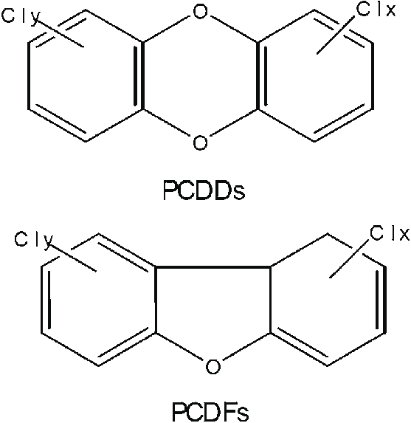
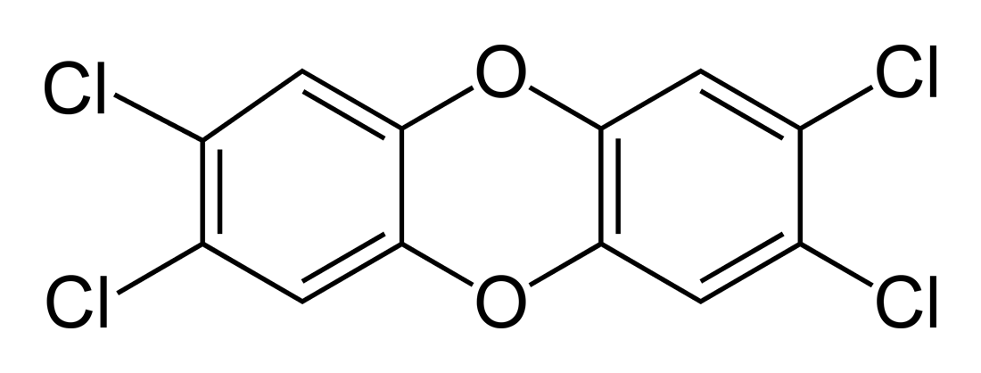
Background – Dioxin and -like Compounds
Large family of chemically and
  structurally similar molecules
PCDDs and PCDFs are two groups
2,3,7,8-tetrachlorodibenzo-p-dioxin is most toxic dioxin
2,3,7,8-tetrachlorodibenzo-p-dioxin
Source: https://commons.wikimedia.org/wiki/File:2,3,7,8-TCDD-2D-skeletal.png
Source: https://www.researchgate.net/figure/Structure-of-PCDDs-and-PCDFs_fig3_51164337

Slide 6
Objectives
Determine if dioxin and dioxin-like compounds are still present in the environment
  Dioxins are a byproduct of combustion
Advising public and environmental health in area
due to toxicity and potential exposure pathways
  Community concern after spraying and natural disasters
  Dioxins are carcinogenic

Slide 7
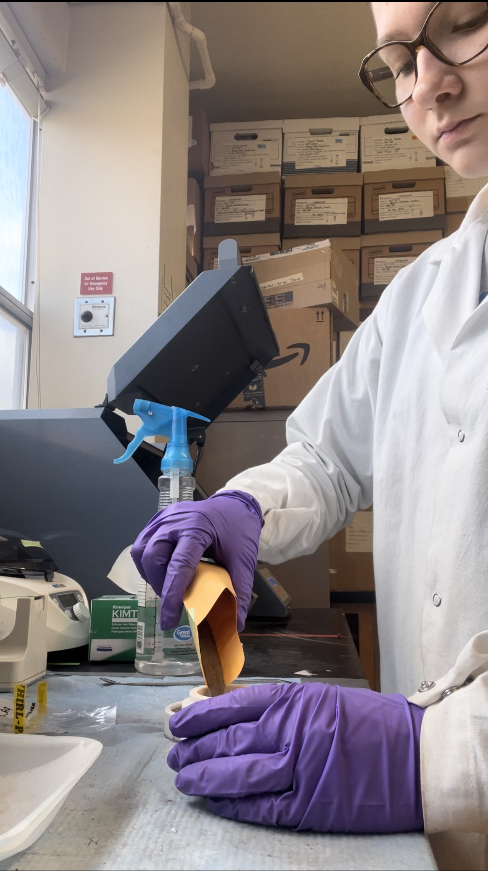
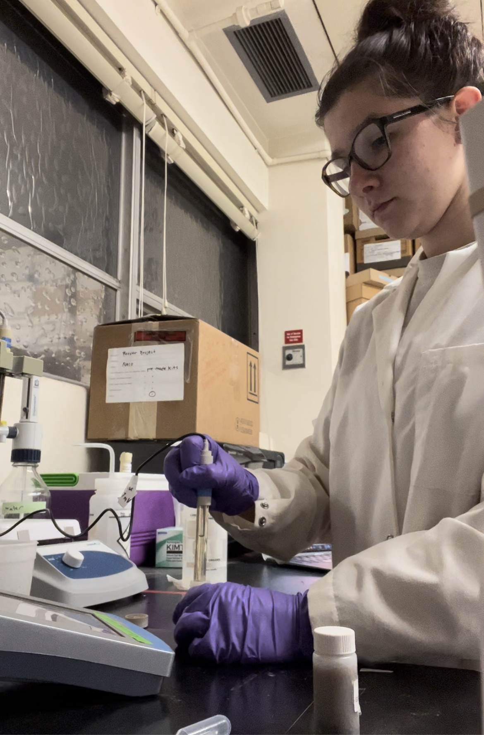
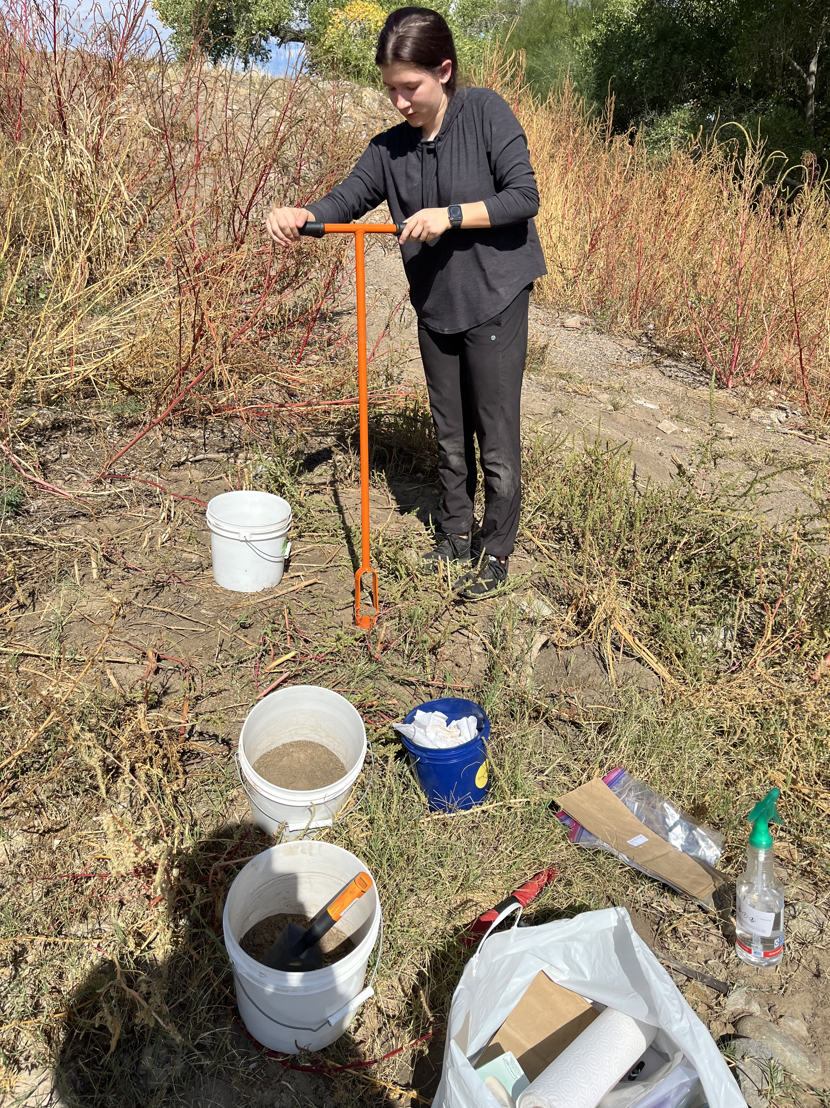
Methodology – Background and Soil Analysis
Extensive literature review and compound
research
Over 200 hours spent in the lab
Processes included sieving, pH/EC, and ball
milling

Slide 8
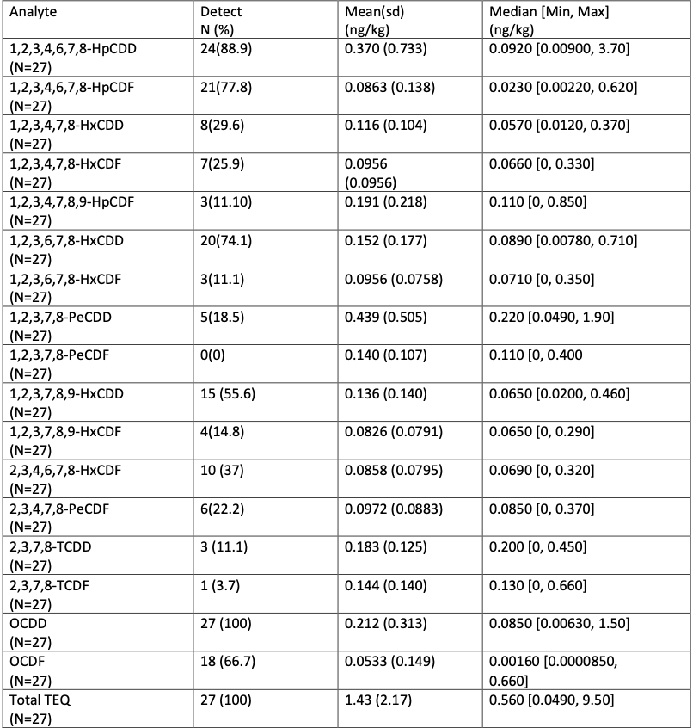
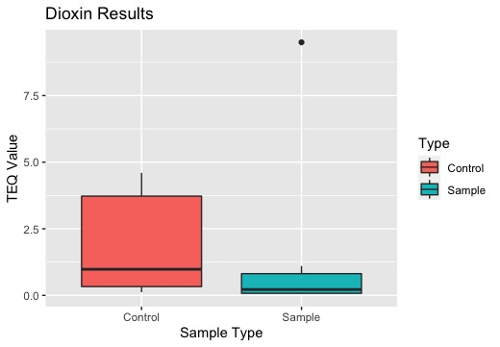
Results
P-value = 0.07482

Slide 9
Conclusions and Future Directions
P-value is not statistically significant
Sample mean is lower than control mean
Control samples were taken in different areas
  Dioxins may have been produced from combustion
  Herbicide was sprayed in this area
Dioxin is still present in these areas
  Community engagement of these results is vital
Further analysis of contamination
Bioremediation efforts

Slide 10
Acknowledgements
Dr. Mónica Ramírez-Andreotta
God’sgift N. Chukwuonye
Zain Alqattan
Lev Brikmanis
Julie Fonseca
Jesika Mesa
Gaby Parra
Alexlis Rivera-Jinel
Alexandra Trahan
Kira Zeider
National Institute of
Environmental Health
Sciences Funding Award
University of Arizona’s College of Agriculture and Life
Sciences iVIP Grant
Department of Environmental
Science
UArizona NASA Space Grant
Program
University of Arizona

Slide 11
Thank You!

